Slide 1
[Organisation] · PHASE C
Software
Distribution
Where twenty-six applications actually run: four locations carrying technology, and three platforms out of support this year
18 nodes · R146.8m a year · 3 out of support in 2027
Draft 0.1 · September 2027

Slide 2
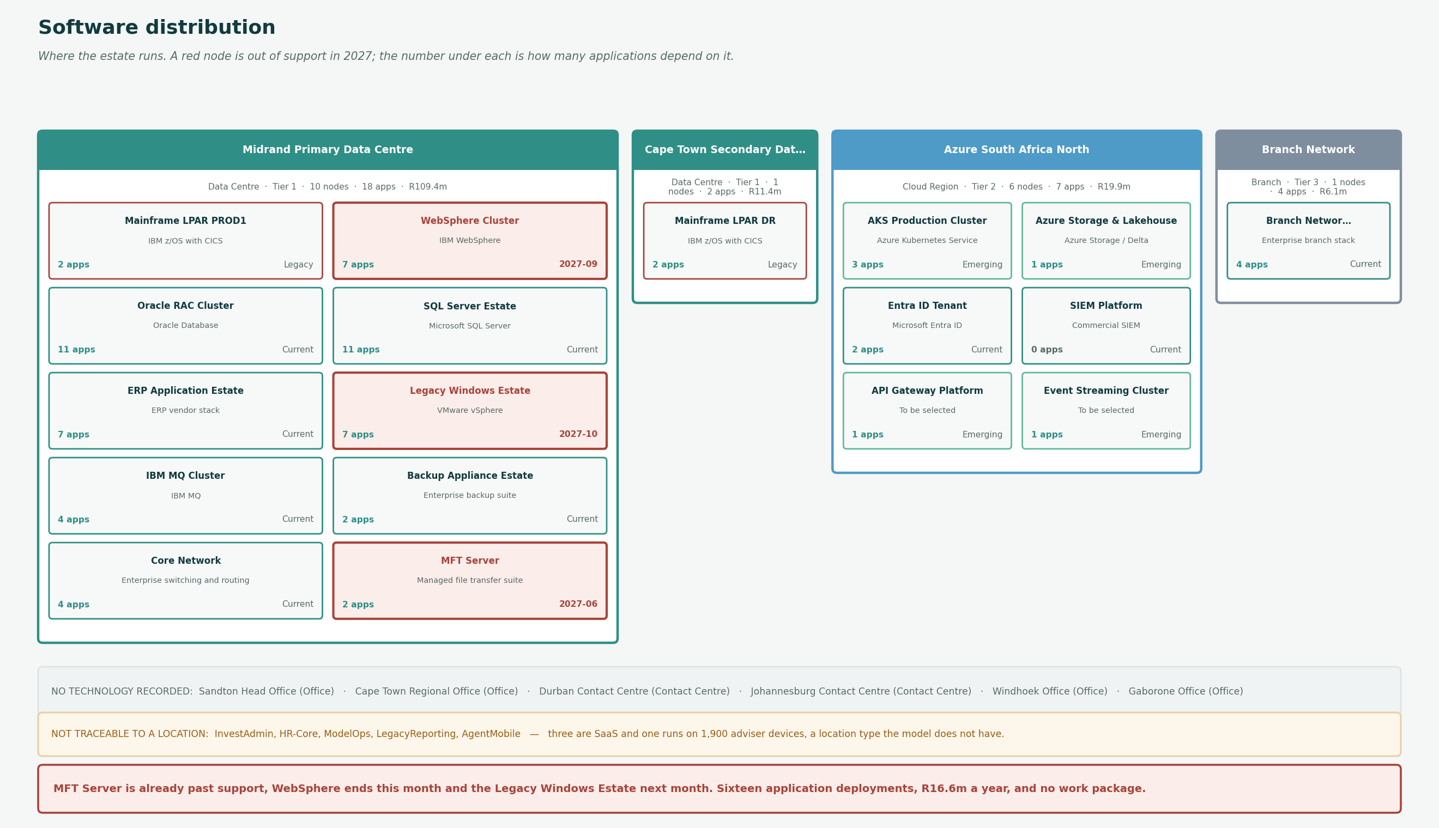
DISTRIBUTION
Where the estate runs
A red node is out of support in 2027. The number under each is how many applications depend on it.

Slide 3
SUPPORT RISK
Three platforms out of support this year
Sixteen application deployments and R16.6m a year sit on technology that is past, or about to pass, its support date.
MFT Server
2027-06
2
R2.2m
Already past support
Managed file transfer suite, 2021
support ends
applications
a year
Carries the batch file transfers between LIFE/400 and the finance estate. Past its support date now.
WebSphere Cluster
2027-09
7
R6.8m
Ends this month
IBM WebSphere 9.0
support ends
applications
a year
Seven applications run on it, including PolicyHub-ST. The replacement is the AKS cluster, which is Emerging and not yet carrying production.
Legacy Windows Estate
2027-10
7
R7.6m
Ends next month
VMware vSphere 7.0
support ends
applications
a year
Seven applications. Marked Contained, which is a statement of intent rather than a plan with a date.
All three are marked Contained rather than Current. That records the intent and not the date.

Slide 4
LOCATIONS
Four locations carry technology
Six carry none. Four of those are offices and contact centres, which is correct. Two are foreign offices, which is a question.
Ref
Location
Type
Country
Criticality
Headcount
Nodes
Apps
Cost Rm
LOC-01
Sandton Head Office
Office
South Africa
Tier 1
2,300
0
0
—
LOC-02
Cape Town Regional Office
Office
South Africa
Tier 2
420
0
0
—
LOC-03
Durban Contact Centre
Contact Centre
South Africa
Tier 1
320
0
0
—
LOC-04
Johannesburg Contact Centre
Contact Centre
South Africa
Tier 1
290
0
0
—
LOC-05
Midrand Primary Data Centre
Data Centre
South Africa
Tier 1
40
10
18
R109.4
LOC-06
Cape Town Secondary Data Centre
Data Centre
South Africa
Tier 1
22
1
2
R11.4
LOC-07
Azure South Africa North
Cloud Region
South Africa
Tier 2
0
6
7
R19.9
LOC-08
Branch Network
Branch
South Africa
Tier 3
640
1
4
R6.1
LOC-09
Windhoek Office
Office
Namibia
Tier 3
120
0
0
—
LOC-10
Gaborone Office
Office
Botswana
Tier 3
85
0
0
—
Cape Town Secondary is Tier 1 and holds one node: the mainframe DR LPAR. Everything else in Midrand has no recorded secondary.

Slide 5
FINDINGS
What the distribution shows
Three platforms go out of support this year and carry sixteen application deployments
MFT Server ended June 2027, WebSphere Cluster ends September 2027 and the Legacy Windows Estate ends October 2027. Between them R16.6m a year.
The managed file transfer server is already past its support date and carries two applications. WebSphere ends this month and carries seven. None of the three appears in a work package, and all three are marked Contained rather than Current, which records the intent and not the date.
Midrand carries three quarters of the technology estate
Ten of eighteen physical components, eighteen of twenty-six applications and R109.4m of the R146.8m.
A Tier 1 primary data centre concentrating that much is normal. What is not is the secondary.
The secondary data centre holds one node, and it is the mainframe
Cape Town Secondary holds only the mainframe DR LPAR, at R11.4m a year, covering two applications.
It is classified Tier 1 and provides disaster recovery for LIFE/400 and ClaimsOne. Everything else in Midrand, including PolicyHub-ST and FinERP, has no recorded secondary. Either the recovery position is narrower than the Tier 1 classification implies, or the technology register is incomplete.
Six locations carry no technology at all
Both head offices, both contact centres and both foreign offices.
Four are expected: staff sit there and use systems hosted elsewhere. Windhoek and Gaborone are not, because a Namibian and a Botswanan office processing South African customer data raises a cross-border question that the register cannot answer either way.
Five applications cannot be traced to a location
InvestAdmin, HR-Core, ModelOps, LegacyReporting and AgentMobile.
Three are SaaS, where no [Organisation] location is the right answer and the register should say so rather than leave it blank. AgentMobile runs on 1,900 advisers' devices, which is a location type the model does not have.
Windhoek and Gaborone process South African customer data and carry no recorded technology. The register cannot answer the cross-border question either way.

